Slide 1
Web-based School Administration and Management System (WebSAMS)
Introduction of transmitting
TSA Student Data file via WebSAMS

Slide 2
HKEAA Module Structure
HKEAA
HKDSE
HKALE/HKCEE
TSA
Three functions:
Maintain Student Data
Report
Data Communication

Slide 3
WebSAMS
Student Module
Relevant Student Data
Security Module
Access Right
TSA Function
Parameter File
HKEAA’s BCA system
CDS
Student Data File

Slide 4
Workflow
Workflow to submit TSA Student Data file via CDS in WebSAMS:
CDS > Incoming Message
Decrypt the parameter file, “TSA parameter file for primary school”
HKEAA > TSA > Data Communication > Process Incoming Data
Import parameter file, “TSA parameter file for primary school”

Slide 5
HKEAA > TSA > Maintain Student Data
Maintain the student data and save
HKEAA > TSA > Data Communication > Prepare Outgoing Data
Prepare the TSA Student Data file and check the report. If there is no problem, confirm the TSA Student Data file
CDS > Outgoing Message > Maintain Message
Encrypt and send the TSA Student Data file

Slide 6
First Step
CDS Incoming Message

Slide 7
Import Parameter File
CDS > Incoming Message
Click the TSA Parameter file

Slide 8
CDS > Incoming Message
Input “School Key”
Then press “Decrypt” button
Press “Decrypt” button

Slide 9
CDS > Incoming Message
File decrypted

Slide 10
Each parameter file is imported for each school level and school session. In case, the school is a through-train school with “AM” and “PM” sessions operated, it has to import three parameter files (i.e. “A.M. Primary school parameter file”, “P.M. Primary school parameter file” and “Secondary school parameter file”).

Slide 11
Import the decrypted parameter
HKEAA > TSA > Data Communication >
Process Incoming Data
Choose parameter file
Press “Import”

Slide 12
HKEAA > TSA > Data Communication >
Process Incoming Data

Slide 13
E-52147: TSA parameter file(s) has / have not yet been imported. For schools with different school levels and/or school sessions, importing ALL relevant TSA parameter files are required.

Slide 14
E-52148: The submission period of student data file of Primary (AM/PM) has not started yet or has already expired.

Slide 15
START
Maintain Student Data

Slide 16
Maintain Student Data
HKEAA > TSA > Maintain Student Data
Select the searching criteria and
press “Search” button

Slide 17
Data that match searching criteria are shown
Default Value =
Original Class Name & Class Number

Slide 18
Modification Change into RED
Newly Admitted Students

Slide 20
If Chinese character (e.g. 三愛) is used for Class Name, user should modify Assigned Class/Group Name into English (e.g. 3A).

Slide 21
Function of “Assign” button
Change by Batch
Enter Assigned Class / Group Name
Select students Press “Assign” button

Slide 22
Press Save button

Slide 23
Continue
Data Communication –
Prepare Outgoing Data

Slide 24
Prepare Outgoing Data
HKEAA > TSA > Data Communication
Click the radio button
Then click “Prepare” button

Slide 25
Select the searching criteria and press “Search” button

Slide 26
Select student data to be prepared and press “Prepare” button

Slide 27
Rectify errors according to the Error Report
View Error Report

Slide 28
If there is no error, the TSA student data file will be prepared for preview

Slide 29
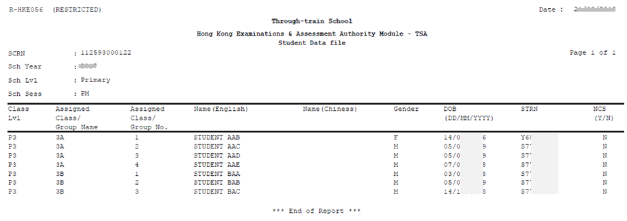
Report Sample

Slide 30
Press “Un-prepare” button if user would like to modify the TSA student data file

Slide 31
Press “Confirm” button if the TSA student data file is correct

Slide 32
The status will change to “Confirmed”

Slide 33
The student data file is ready to be sent out via CDS

Slide 34
Continue
CDS > Outgoing Message

Slide 35
Maintain message
CDS > Outgoing Message > Maintain Message
Click the TSA Student Data File

Slide 36
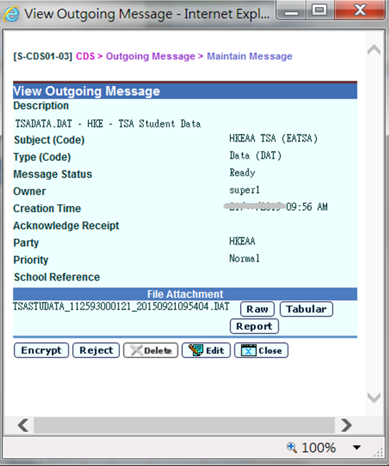
Enter School Key
Then Press “Encrypt” button
Press “Encrypt” button

Slide 38
CDS > Transmission > Ad hoc Transmission
For Instant transmission:
Go to CDS > Transmission > Ad hoc Transmission Then press “Start” button

Slide 39
CDS > Outgoing Message > Maintain Message
Change to “Sent” status

Slide 40
CDS > Outgoing Message > Maintain Message
Change to “Received” status

Slide 41
Continue
Report

Slide 42
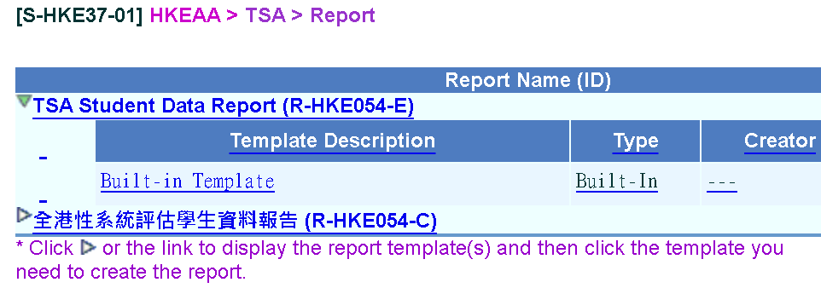
Report
Choose English or Chinese Version
Choose “Built-in Template”

Slide 43
The information on report is based on the latest confirmed and sent TSA Data File
Select print criteria
Then press “Preview & Print” button

Slide 44
Report Sample

Slide 45
References

Slide 46
WebSAMS Build Version
Build Version 3.1.18
or above

Slide 47
http://cdr.websams.edb.gov.hk

Slide 48
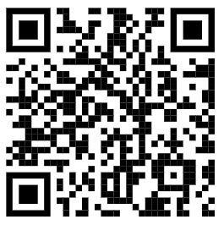
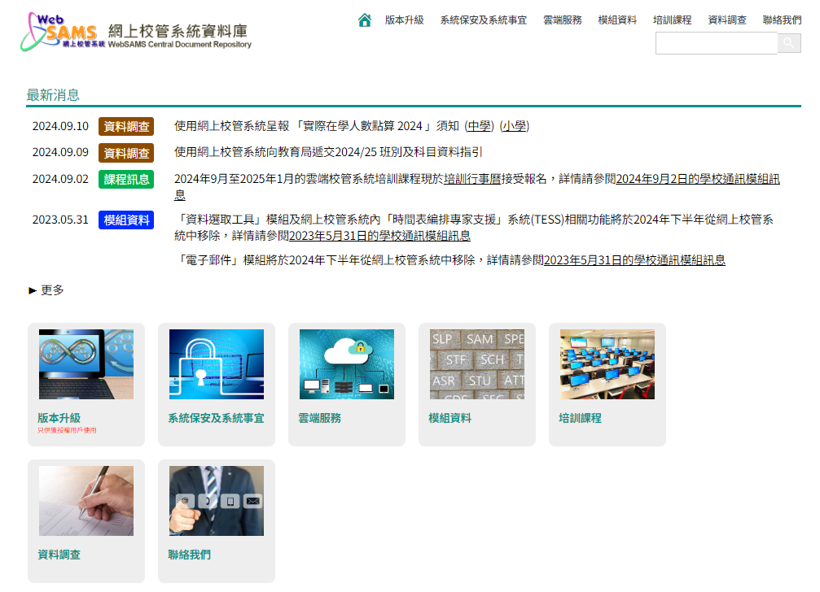

Slide 49
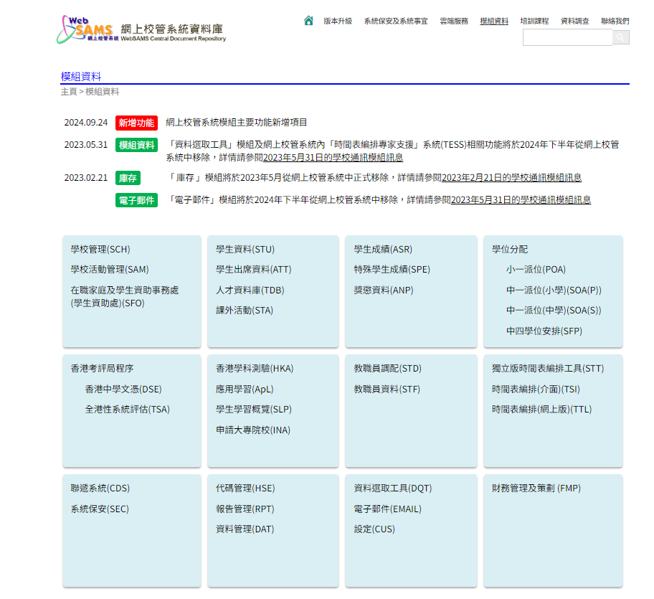

Slide 50
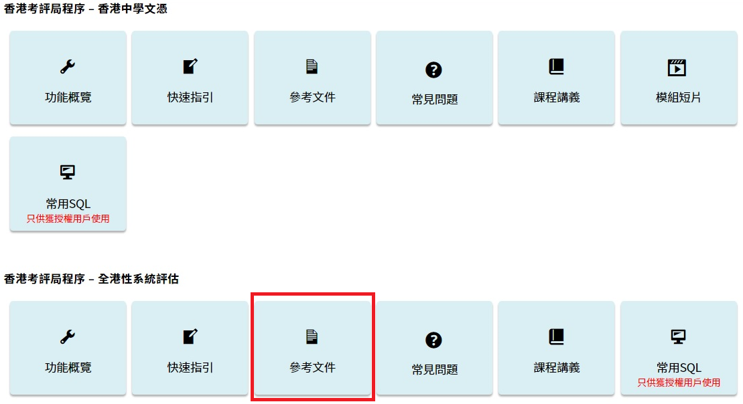

Slide 51
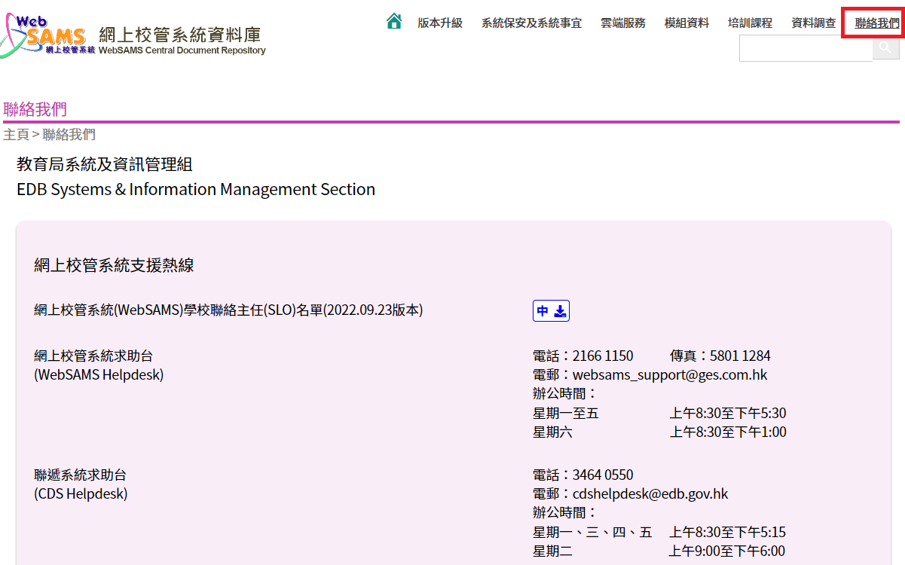

Slide 52
- End -

