Slide 1
線上培訓課程系列
申請大專院校(INA)

Slide 2
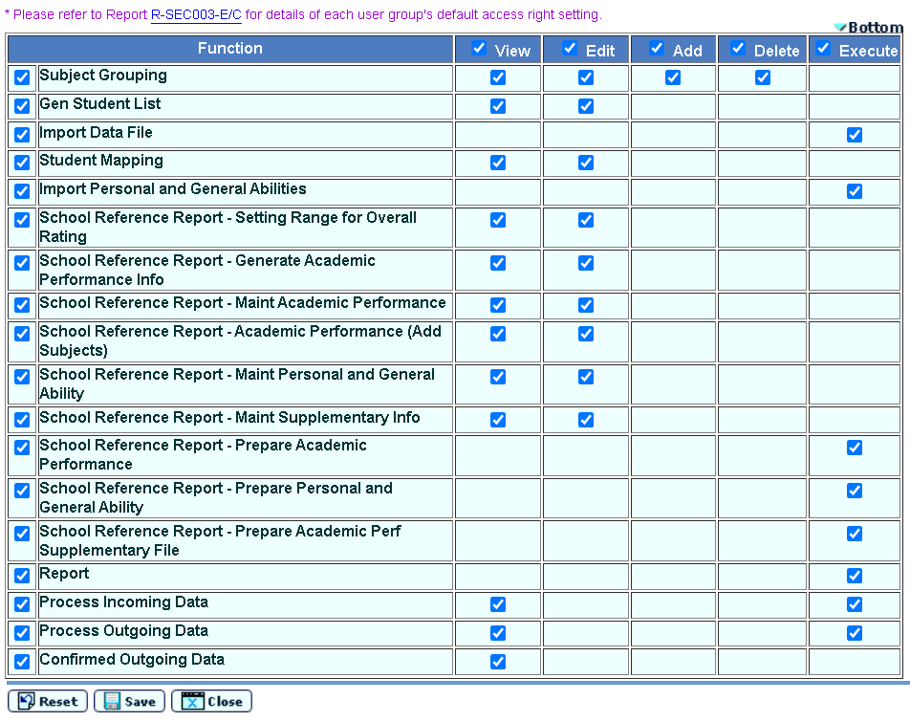
Preparation Work 1
Access right: School head, System admin & INA admin
School head & System admin may assign access right to other staff

Slide 3
Preparation Work 2
To facilitate data exchange between JUPAS online application system & WebSAMS, JUPAS Student List can only be available after submission of student information to JUPAS office and completion of student registration at JUPAS portal
A Data File Structure for School is posted under Download Area of school’s JUPAS account (for School Head, Teacher-in-charge & Class / Group Teacher)

Slide 4
Preparation Work 3
If Assessment Module (ASR) is used, Academic Performance in School can be generated via School Reference Report (SRR) from WebSAMS
Can choose school year (S5 and/or S6) and assessment (e.g. T1A1, T1 or Annual) (max two entries) that best reflect students’ performance subject to schools’ selection
Exam results can be exported in Percentile and Overall Rating from WebSAMS to JUPAS online application system

Slide 5
Institute Application (INA) Operation
For extracting S6 student data for JUPAS and E-APP applications
Sep Applications for JUPAS
Student Data Extraction and School Reference Report (SRR) Generation
- Prepare Academic Performance, Personal and General Abilities and Academic Performance Supplementary Information
- Generate SRR
Student List Generation
Submit Data via JUPAS Portal
JUPAS Student Account Creation
Import Student Registration No and Subject Code to WebSAMS
School Reference Report (SRR) Submission
Export and submit Data via JUPAS Portal
Dec Applications for E-APP
Student List and SRR Generation
Extract Student Data and generate SRR
Student Data Submission
Export Student List and SRR (optional) to E-APP Portal via CDS

Slide 6
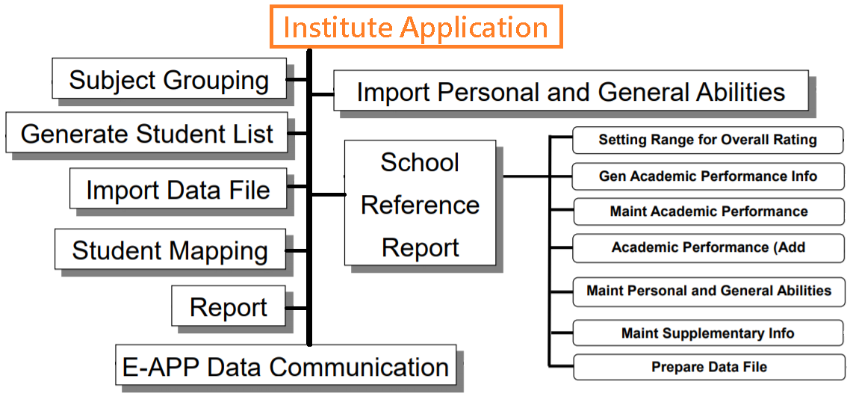
Module Flow Chart

Slide 7
JUPAS
Work Flow

Slide 8
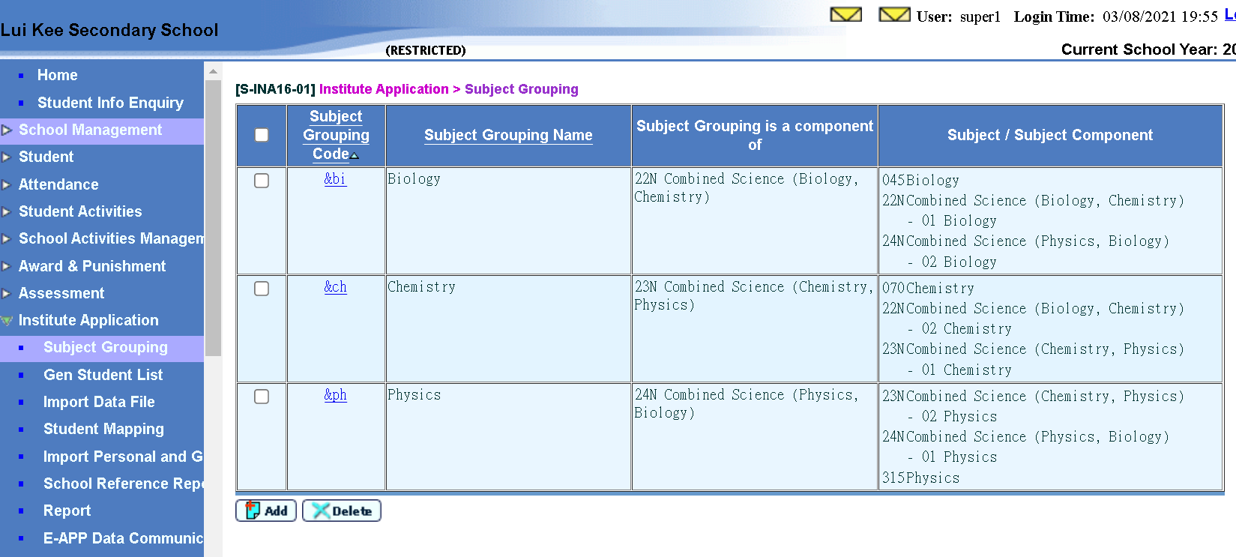
Subject Grouping
Institute Application > Subject Grouping

Slide 9
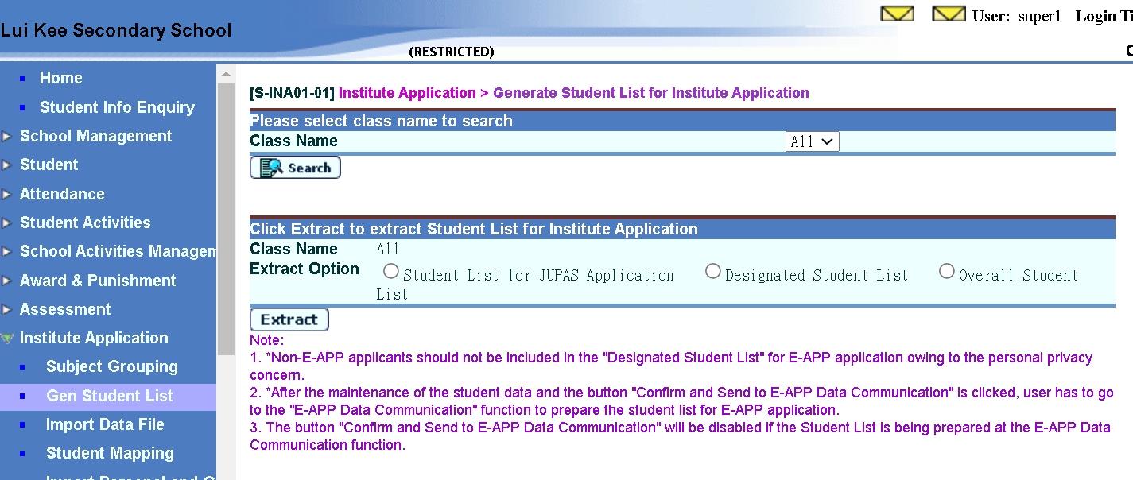
Generate Student List(1)
Institute Application > Generate Student List for Institute Application

Slide 10
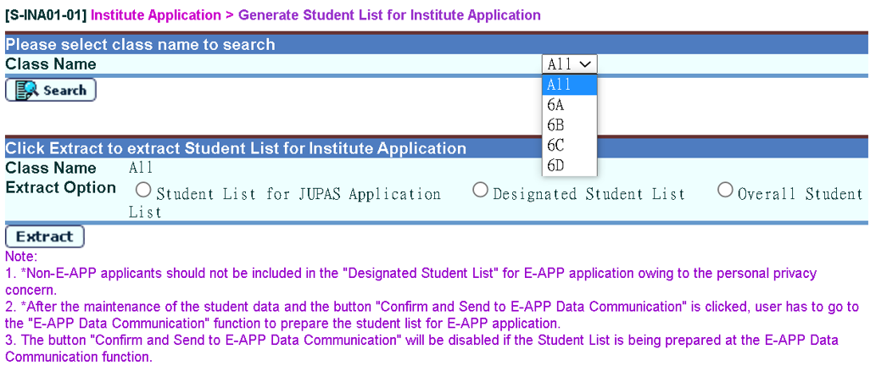
Generate Student List(2)
Institute Application > Generate Student List for Institute Application

Slide 11
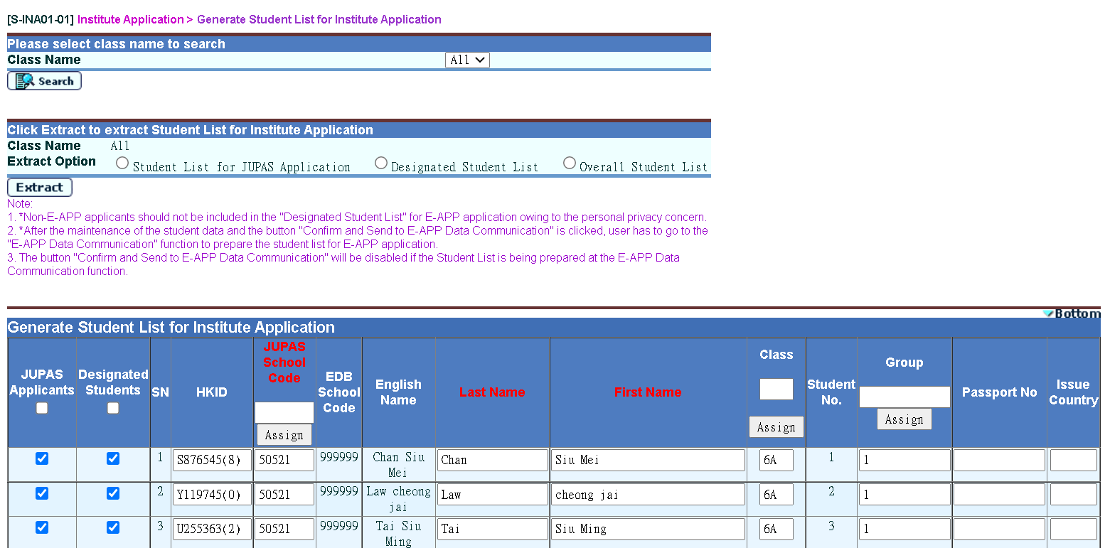
Generate Student List(3)
Institute Application > Generate Student List for Institute Application

Slide 12
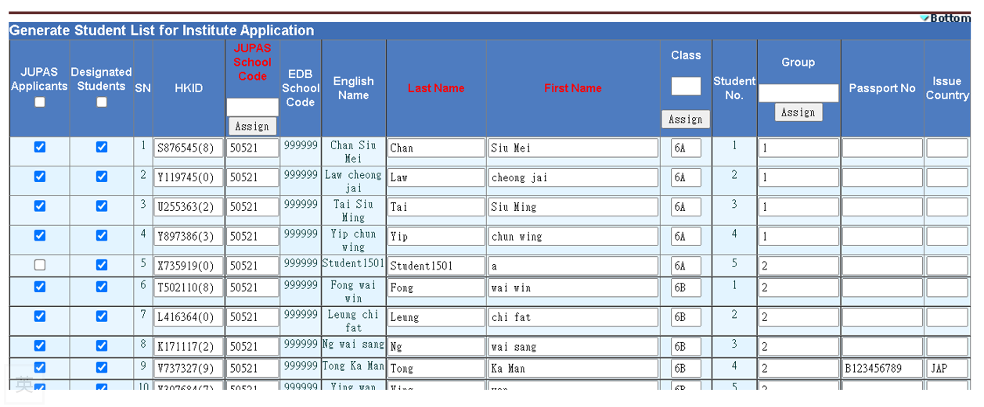
Generate Student List(4)
Institute Application > Generate Student List for Institute Application

Slide 13
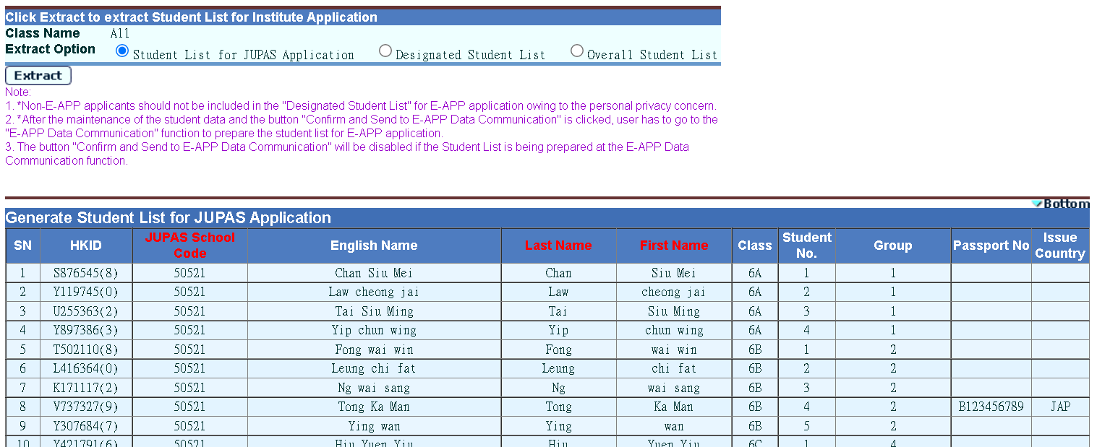
Generate Student List(5)
Institute Application > Generate Student List for Institute Application
Checking applicants before pressing [Confirm] button

Slide 14
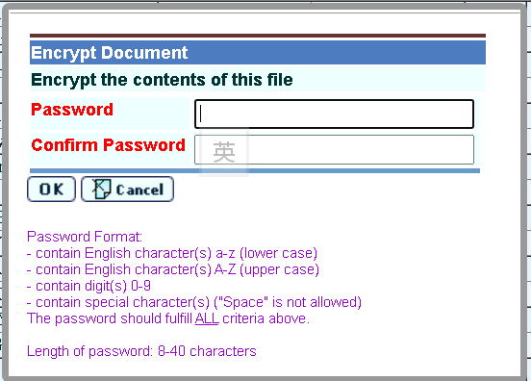

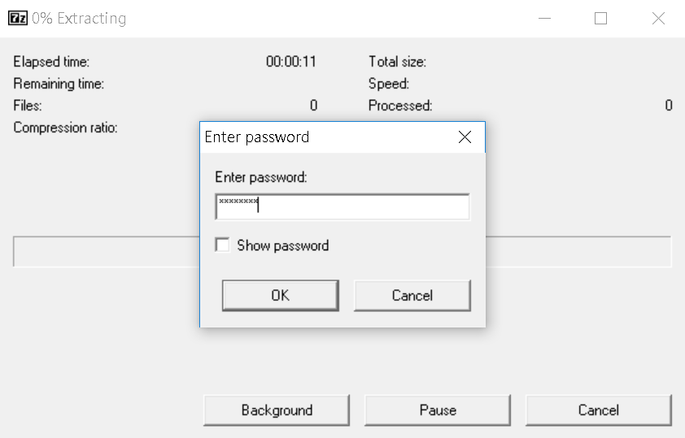
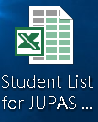
Generate Student List(6)
Institute Application > Generate Student List for Institute Application (After pressing [Confirm] button)

Slide 15
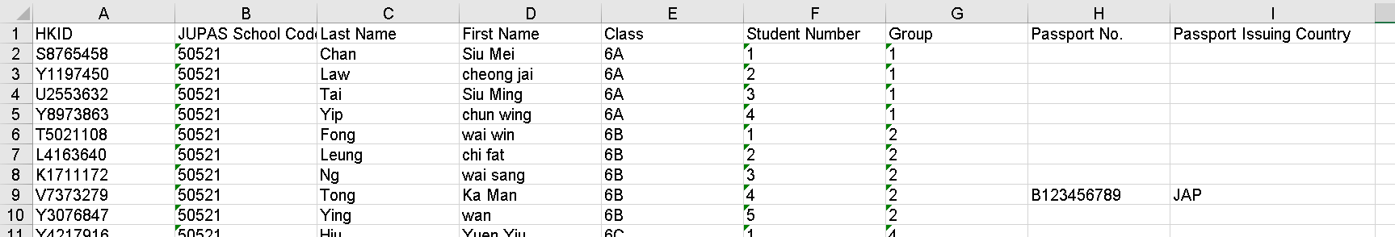
Generate Student List(7)
Institute Application > Generate Student List for Institute Application
  Submit this student information to JUPAS Office
  (https://www.jupas.edu.hk/en/)

Slide 16
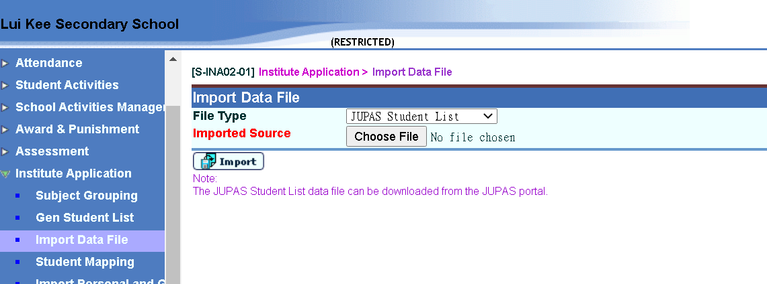
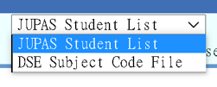
Import Data File(1)
Institute Application > Import Data File
(Refer to Preparation Work 2)

Slide 17
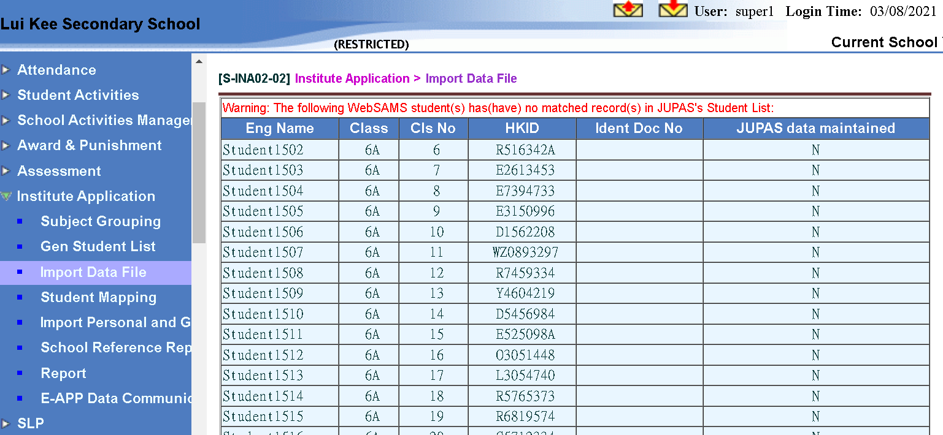
Import Data File(2)
Checking the irregularities
Institute Application > Import Data File

Slide 18
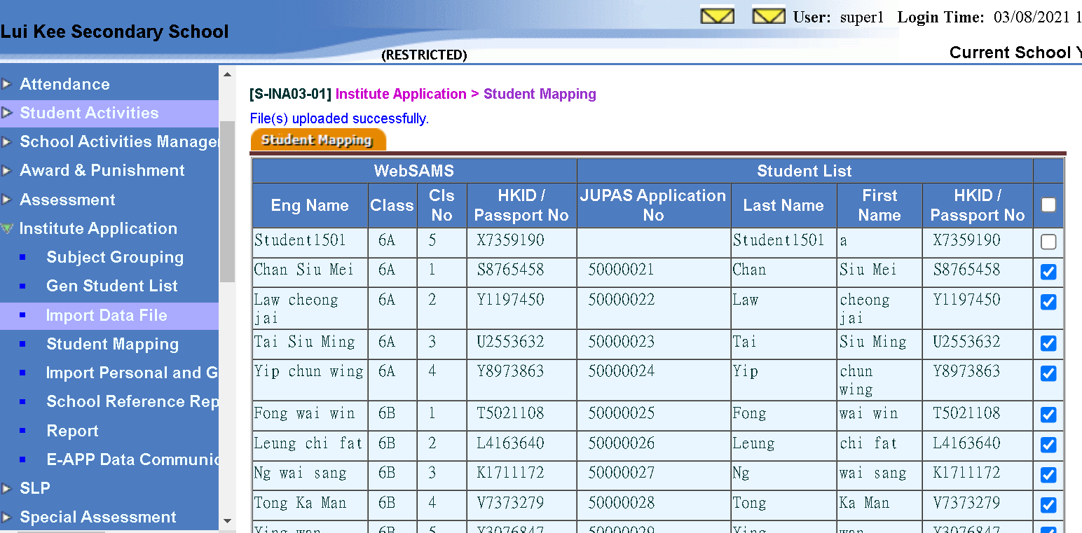
Import Data File(3)
Checking the applicants
Institute Application > Import Data File

Slide 19
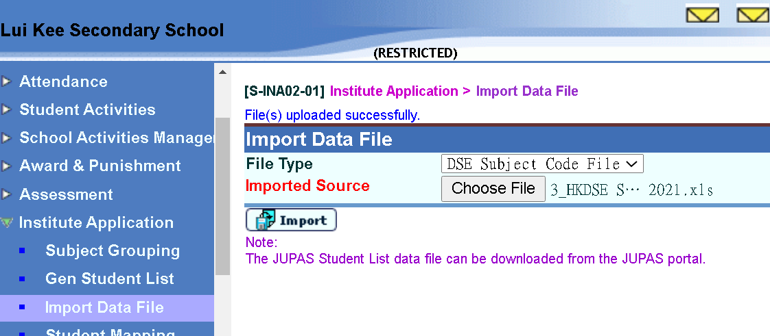
Import Data File(4)
Institute Application > Import Data File
  (Refer to FAQ question 2)

Slide 20
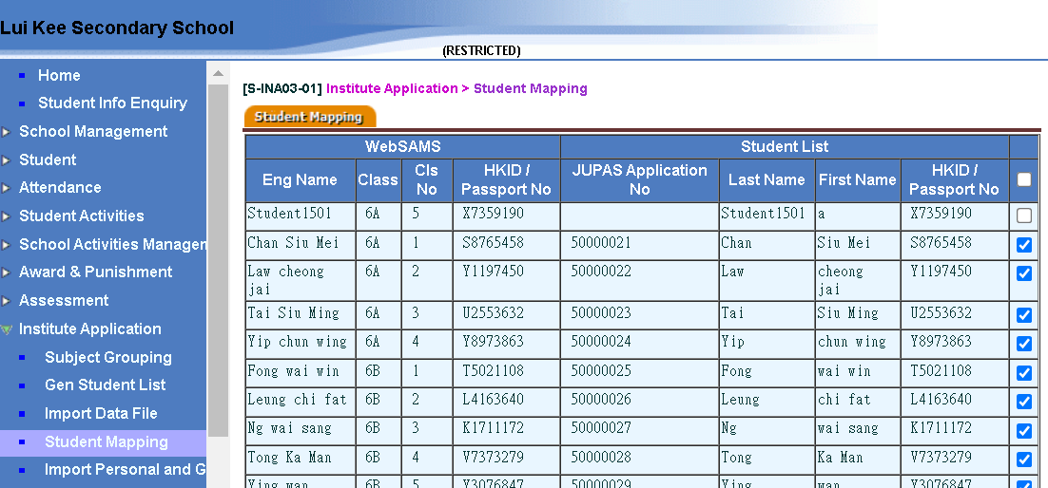
Student Mapping
Institute Application > Student Mapping
Checking the applicants
Institute Application > Student Mapping
  Uncheck the applicant(s) if necessary

Slide 21
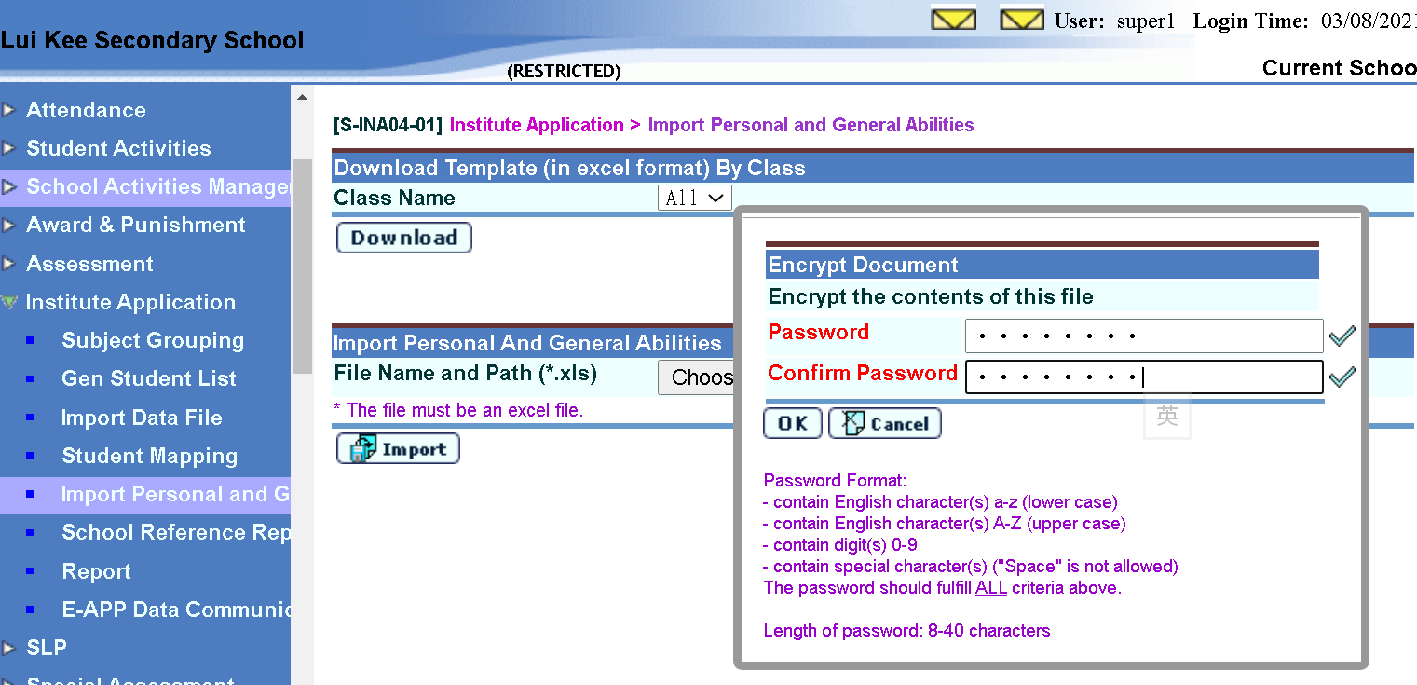
Import Personal and General Abilities(1)
Institute Application > Import Personal and General Abilities

Slide 22

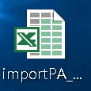
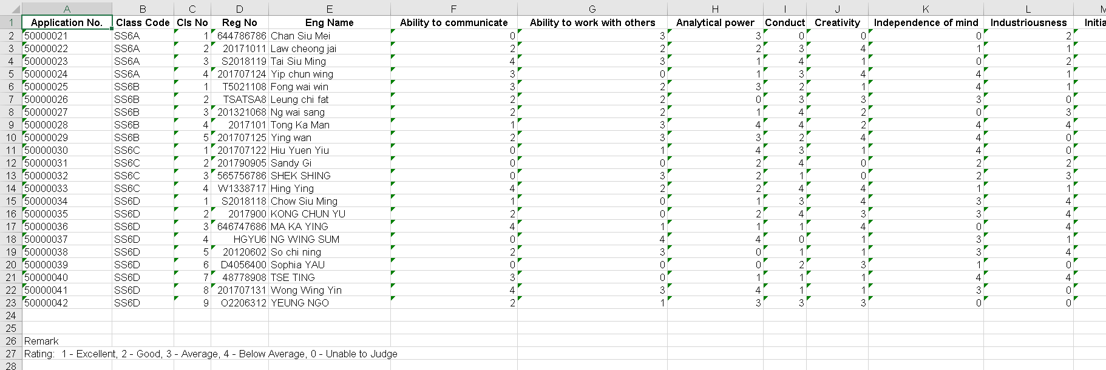
Import Personal and General Abilities(2)
Institute Application > Import Personal and General Abilities
13 items to be assessed

Slide 23
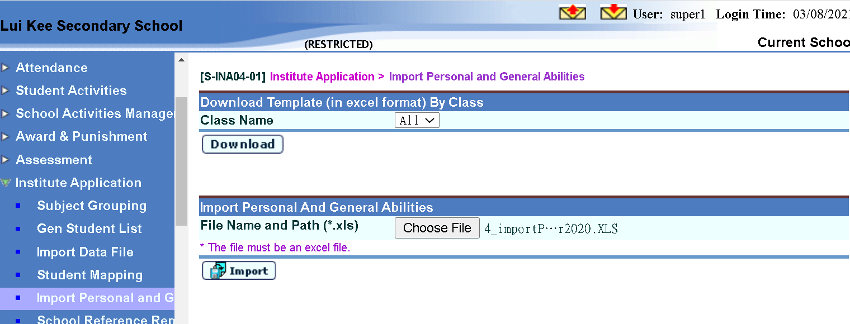
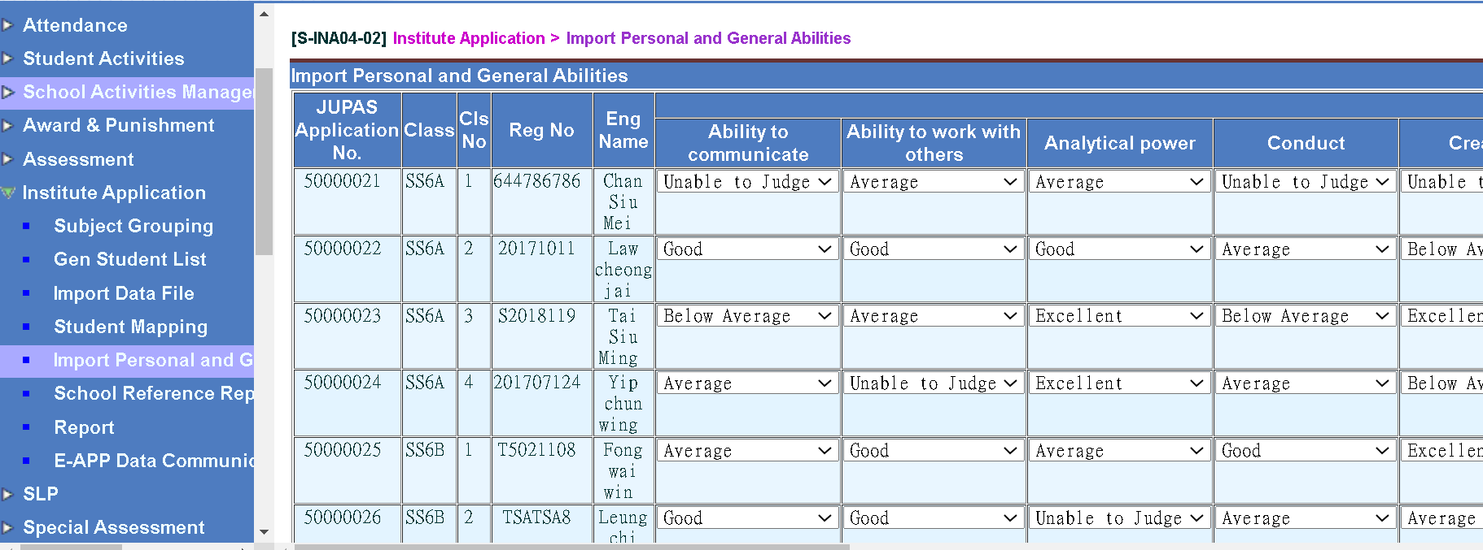
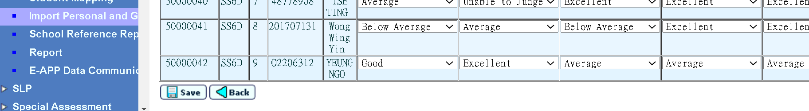
Import Personal and General Abilities(3)
Institute Application > Import Personal and General Abilities

Slide 24
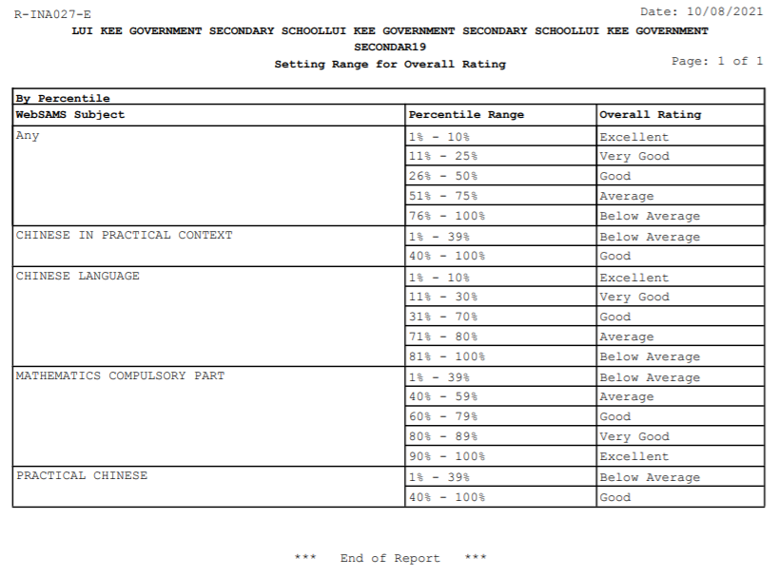
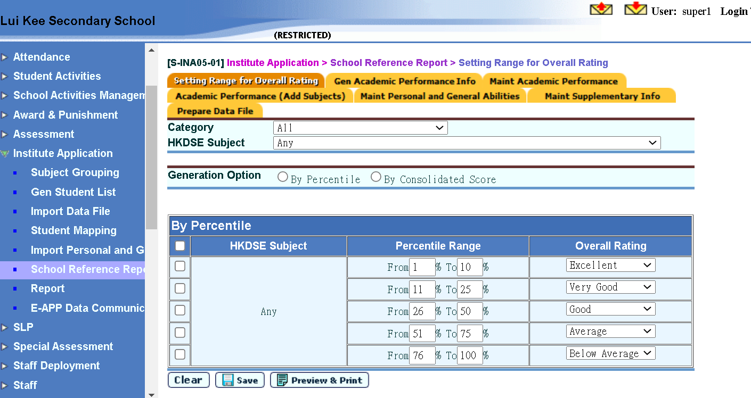
School Reference Report(SRR)(1)
Institute Application > School Reference Report > Setting Range for Overall Rating

Slide 25
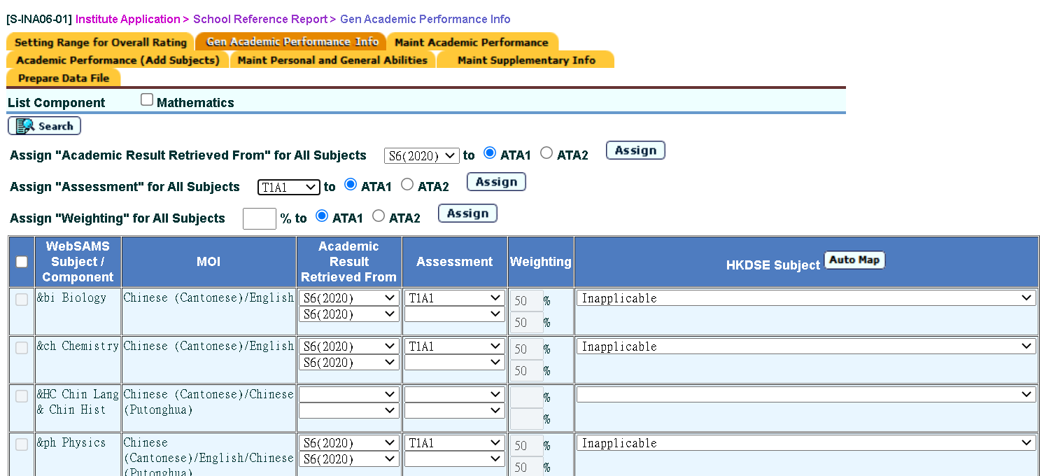
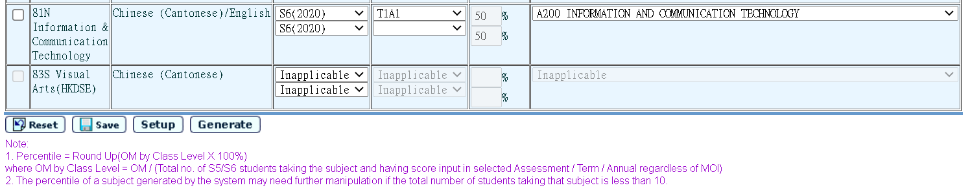
School Reference Report(SRR)(2)
Institute Application > School Reference Report > Gen Academic Performance Info (Press [Generate] to extract results from ASR; refer to Preparation Work 3)

Slide 26
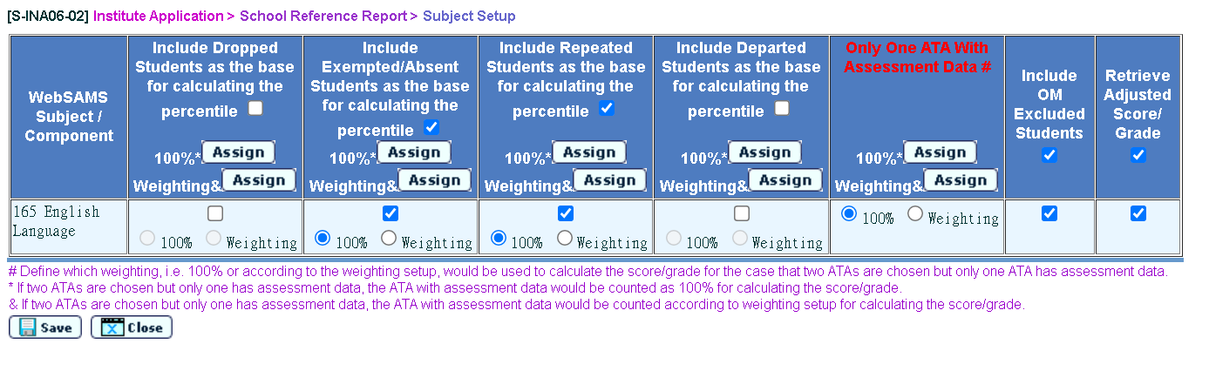
School Reference Report(SRR)(3)
Institute Application > School Reference Report > Gen Academic Performance Info (Check the subject(s) and press [Setup] to fine-tune)

Slide 27
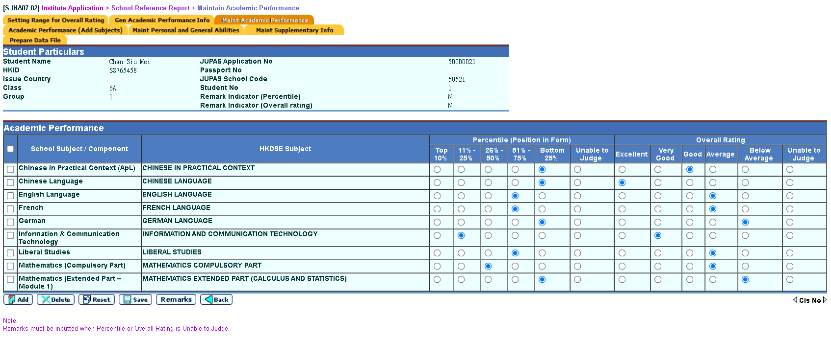
School Reference Report(SRR)(4)
Institute Application > School Reference Report > Search Student (Fine-tune student’s Academic Performance)

Slide 28
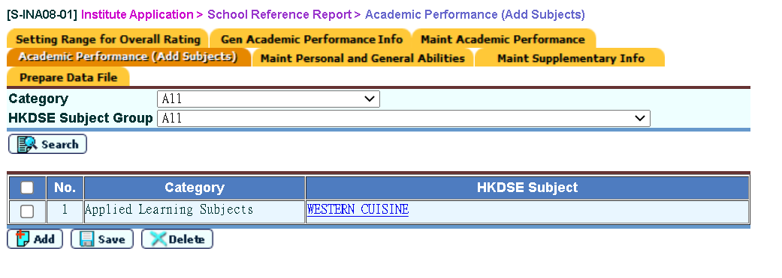
School Reference Report(SRR)(5)
Institute Application > School Reference Report > Academic Performance (Add Subjects)

Slide 29
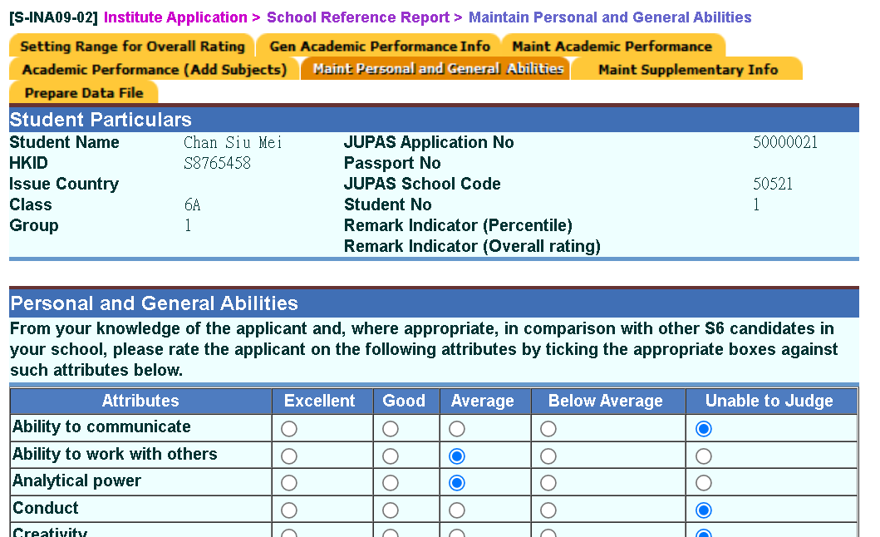
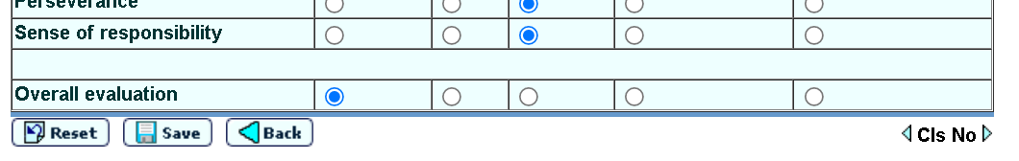
School Reference Report(SRR)(6)
Institute Application > School Reference Report > Search Student (Fine-tune student’s Personal & General Abilities)

Slide 30
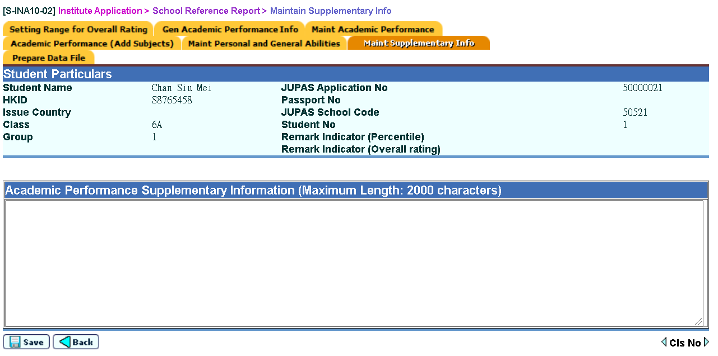
School Reference Report(SRR)(7)
Institute Application > School Reference Report > Search Student (Highlight student’s extra Academic Performance)

Slide 31
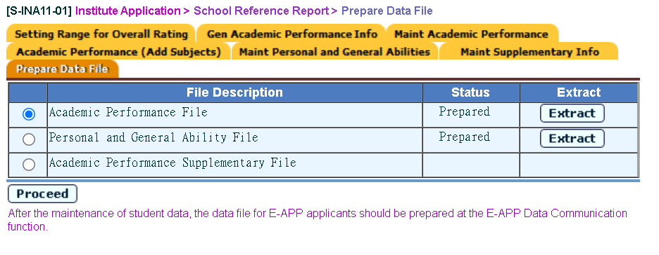
School Reference Report(SRR)(8)
Institute Application > School Reference Report > Prepare Data File

Slide 32
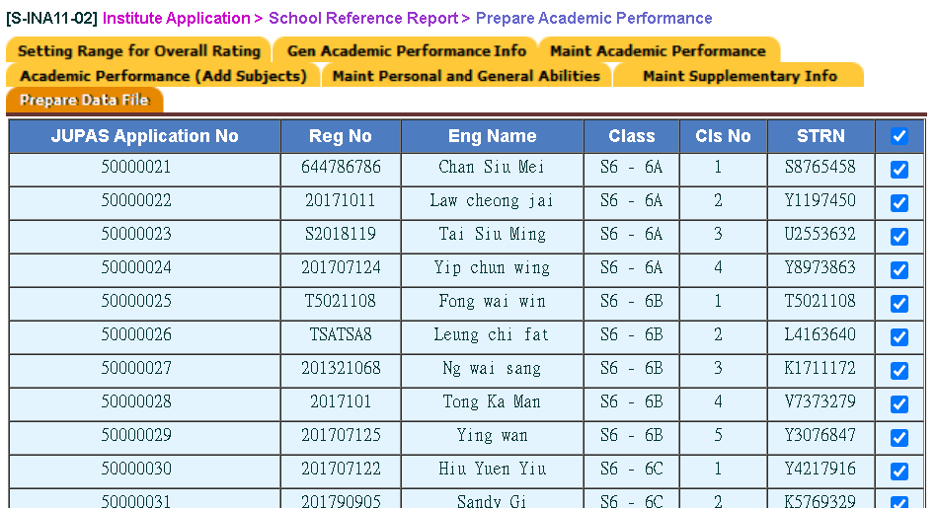
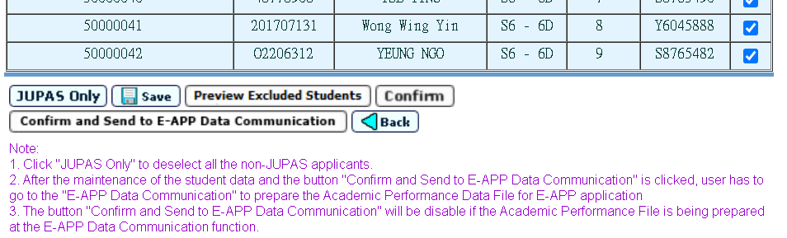
School Reference Report(SRR)(9)
Institute Application > School Reference Report > Prepare Data File (Select the appropriate applicants)
Note of working steps for submission

Slide 33
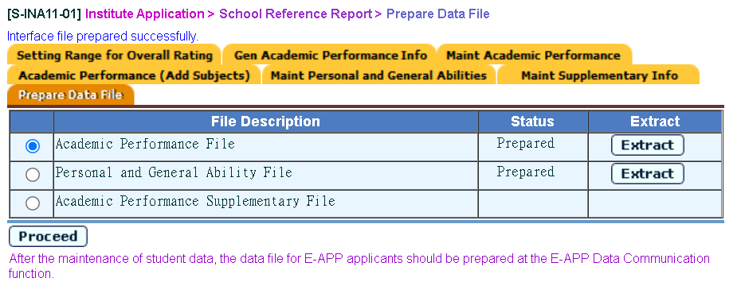
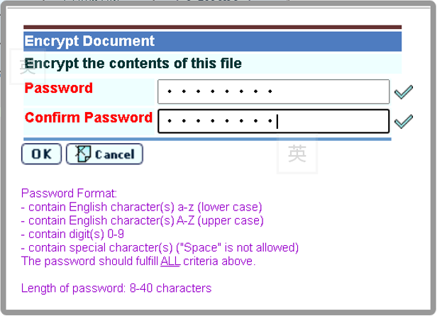
School Reference Report(SRR)(10)
Institute Application > School Reference Report > Prepare Data File (Extract three data files to JUPAS Portal)

Slide 34


School Reference Report(SRR)(11)
Institute Application > School Reference Report > Prepare Data File (Extract three data files to JUPAS Portal)

Slide 35
E-APP
Work Flow

Slide 36
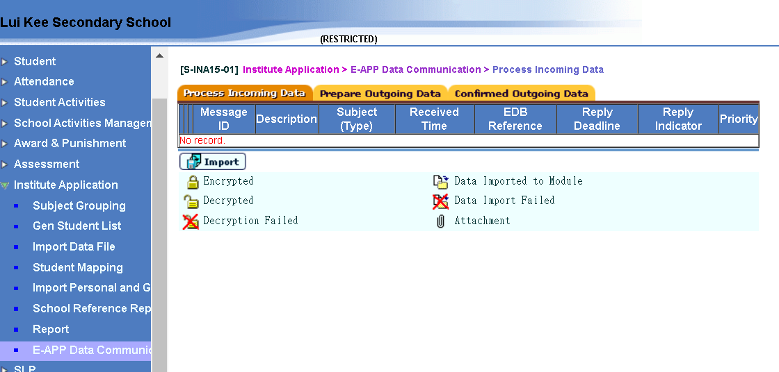
Process Incoming Data
Institute Application > E-APP Data Communication > Process Incoming Data
  Decrypt the Parameter File which is sent from E-APP System(EDB) via CDS and import it here

Slide 37
Generate Student List(1)
Institute Application > Generate Student List for Institute Application

Slide 38
Generate Student List(2)
Institute Application > Generate Student List for Institute Application

Slide 39
Generate Student List(3)
Institute Application > Generate Student List for Institute Application

Slide 40
Generate Student List(4)
Institute Application > Generate Student List for Institute Application

Slide 41
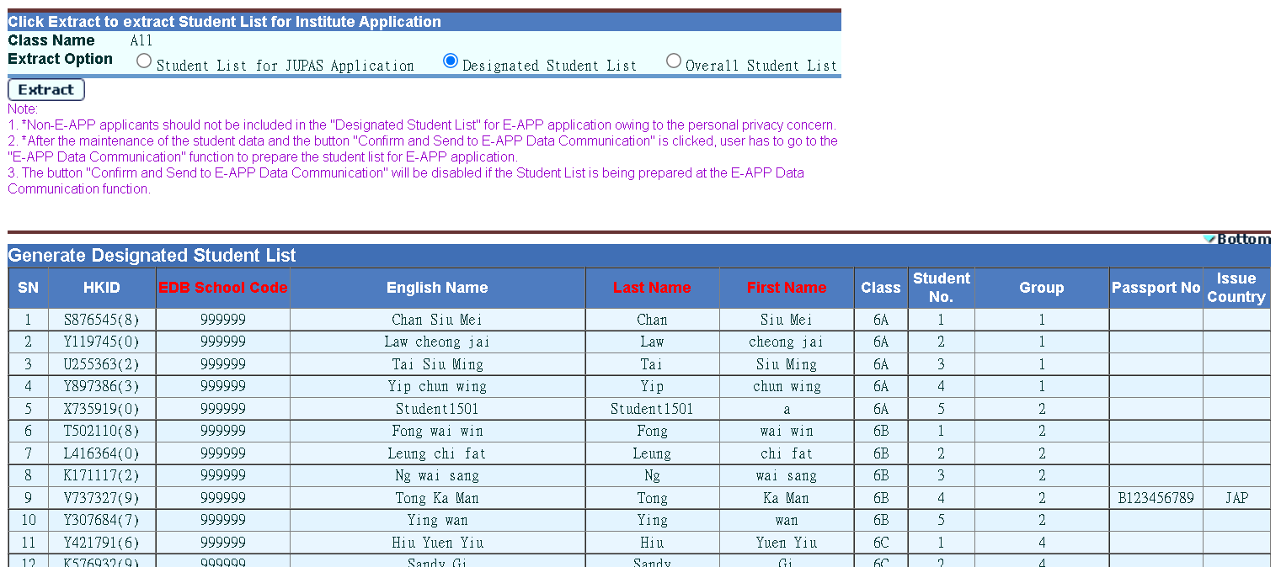
Generate Student List(5)
Institute Application > Generate Student List for Institute Application
Checking applicants before pressing [Confirm] button

Slide 42
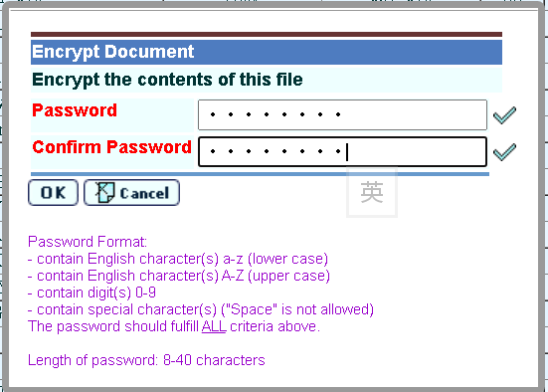


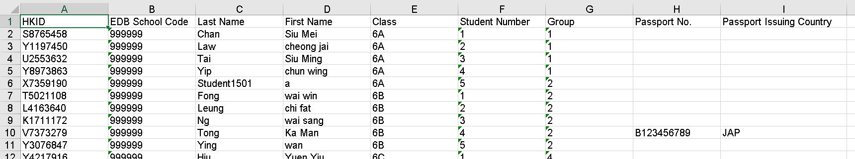
Generate Student List(6)
Institute Application > Generate Student List for Institute Application (After pressing [Confirm] button)

Slide 43
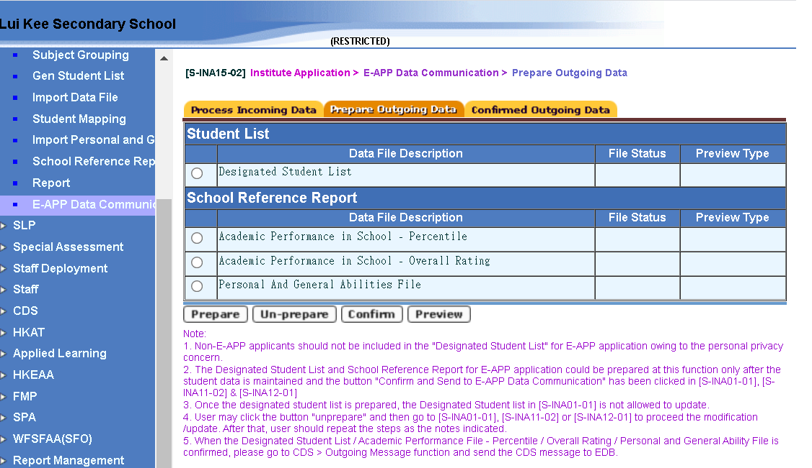
Generate Student List(7)
Institute Application > E-APP Data Communication > Prepare Outgoing Data (After pressing [Confirm and Send to E-APP Data Communication] button)
Note of working steps for submission

Slide 44
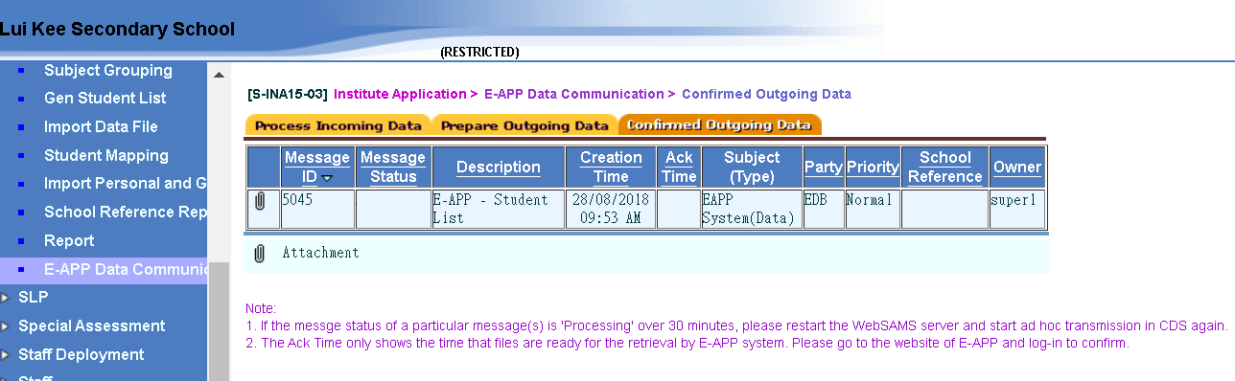
Institute Application > E-APP Data Communication > Confirmed Outgoing Data
Note of working steps after submission

Slide 45
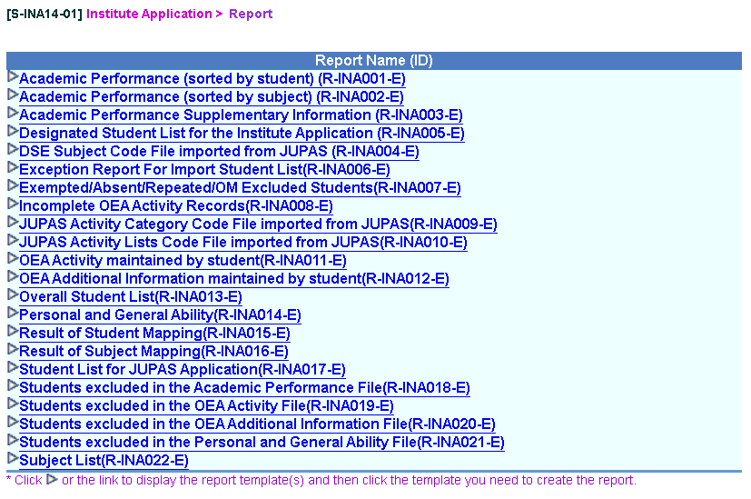
Report
Institute Application > Report

Slide 46
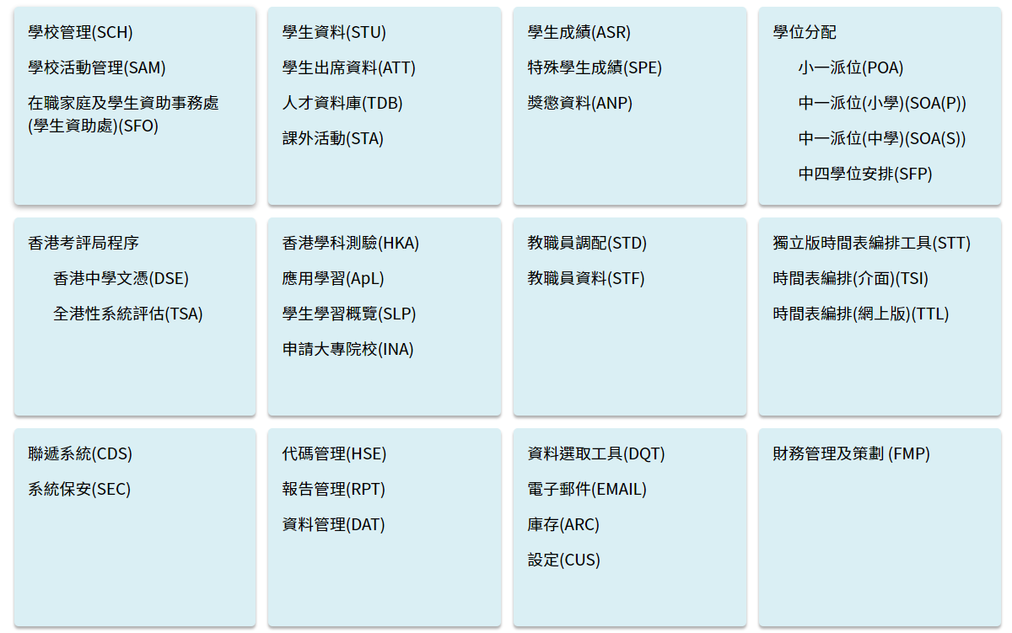
網上系統資料庫 - 模組參考資料
主頁>模組資料>申請大專院校(INA)

Slide 47
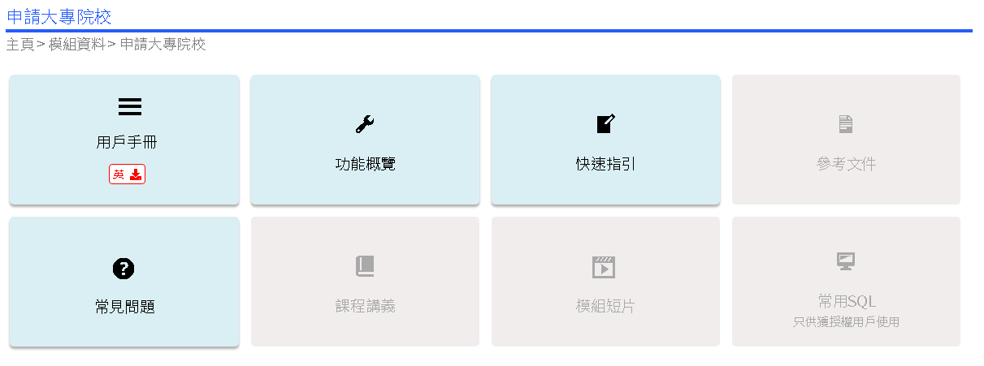
網上系統資料庫 - 模組參考資料

Slide 48
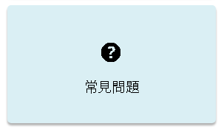
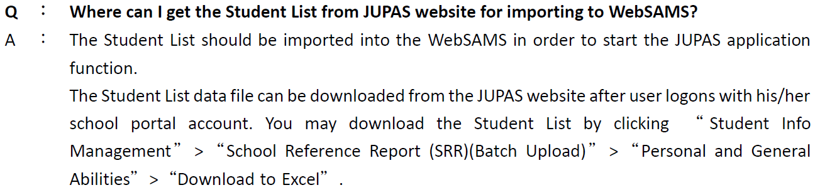

常見問題(FAQ)
主頁 > 模組資料 > 申請大專院校(INA)
常見問題
1.
2.

Slide 49

主要功能新增項目
主頁>模組資料>模組訊息>網上校管系統主要功能新增項目(中文版)

Slide 50

學生成績模組近年主要功能新增項目

Slide 51
有用資料
    JUPAS Office
    Enquiry Hotline: 2334 2929 / 2233 2929
Email: info@jupas.edu.hk
    專上課程預先報名平台
  電話 : 3104 2560
  電郵 : eapp_post_sec@edb.gov.hk

